Slide 1
CSE 490V VIRTUAL REALITY SYSTEMS
TEASER IMAGE
replace with a representative image for your project
Project Title
Student One and Student Two

Slide 2
DELETE THIS SLIDE
Your team presentation should be no longer than 10 minutes. We suggest planning on 8 minutes of presentation, leaving 2 minutes for audience questions and dealing with A/V issues.
This slide deck is a suggested template, but you do not have to follow it directly. You can change any element, so long as you present a thorough review of your final project. You are required to turn in your slides, as a pdf file, but you don’t have to use PowerPoint or follow this deck precisely. That being said, starting with this deck and modifying the slides to fit your material should help you craft an effective presentation that covers all the aspects we expect to hear about in the final presentations.

Slide 3
MOTIVATION
Discuss what motivated you to select this final project, preferably using large images or videos that fill the entire slide. Try to make this visual and use your narration to explain things, rather than lots of bullet points. Think about what commercial products, applications, or academic works inspired you and what it is you’re trying to prove, test, or demonstrate through your project. Audience members should agree this is a worthwhile problem to work on, after this slide (or set of slides) is presented.

Slide 4
OVERVIEW
Present a high-level “teaser” for your project. Again, try to keep this visual, rather than using lots of text. Explain the primary contributions you made, including what software you implemented and/or what hardware you built. Make sure to explain the key results and “take home” lessons. For example, if you made a user study and learned something, just go ahead and tell the audience the conclusion now, so they are motivated to listen to how you arrived at that conclusion. Your goal is to get the audience excited about your project so that they’ll pay attention to the rest of the talk.

Slide 5
RELATED WORK

Slide 6
TOPIC 1
Key related work should be explained in this section. The emphasis should be on comparing and contrasting the approaches taken to your problem in the past. Try to provide some taxonomy to think about prior methods (e.g., major categories). Also try to point out the known benefits and limitations of prior methods. Your goal is to be thorough and honest in this section. You don’t want an audience member to point out a key piece of related work that you missed or misrepresented. Your goal is to show that you’re done a thorough literature search and, based on that, you think your approach is novel. (If your approach isn’t novel for this final project, that’s okay; but, you’ll want to explain what prior work you’re implementing clearly and why you selected it over alternatives.

Slide 7
TOPIC 2
Key related work should be explained in this section. The emphasis should be on comparing and contrasting the approaches taken to your problem in the past. Try to provide some taxonomy to think about prior methods (e.g., major categories). Also try to point out the known benefits and limitations of prior methods. Your goal is to be thorough and honest in this section. You don’t want an audience member to point out a key piece of related work that you missed or misrepresented. Your goal is to show that you’re done a thorough literature search and, based on that, you think your approach is novel. (If your approach isn’t novel for this final project, that’s okay; but, you’ll want to explain what prior work you’re implementing clearly and why you selected it over alternatives.

Slide 8
TOPIC 3
Key related work should be explained in this section. The emphasis should be on comparing and contrasting the approaches taken to your problem in the past. Try to provide some taxonomy to think about prior methods (e.g., major categories). Also try to point out the known benefits and limitations of prior methods. Your goal is to be thorough and honest in this section. You don’t want an audience member to point out a key piece of related work that you missed or misrepresented. Your goal is to show that you’re done a thorough literature search and, based on that, you think your approach is novel. (If your approach isn’t novel for this final project, that’s okay; but, you’ll want to explain what prior work you’re implementing clearly and why you selected it over alternatives.

Slide 9
METHOD

Slide 10
EXPLAINATION OF THEORY/CONCEPT
This section should explain the theory behind your approach. It should emphasize the underlying mathematics, image formation models, or other fundamental concepts. If you are describing an application, then your “method” and “implementation” sections may be combined into a single section. The goal is to convey all the core concepts needed to solve the problem, not the specific hardware and software used in your solution. If you’re going to have equations in your talk, then this is the section to put them in.

Slide 11
IMPLEMENTATION DETAILS

Slide 12
HARDWARE AND SOFTWARE DISCUSSION
In this section you can go into the specific hardware and software you used. If you built something, then show photographs and videos of how it was constructed. Again, full slide visuals are much better than lots of text and bullet points. You should include screenshots and video clips of your demo. Consider using your mobile phone to record a video of someone using your system. Your goal is to let the audience feel like they have tried the demo and understand what the results would be like in person. The secondary goal is to make sure you’ve documented the work well enough to share it in the future, long after the specific demo hardware and software are no longer available or working.

Slide 13
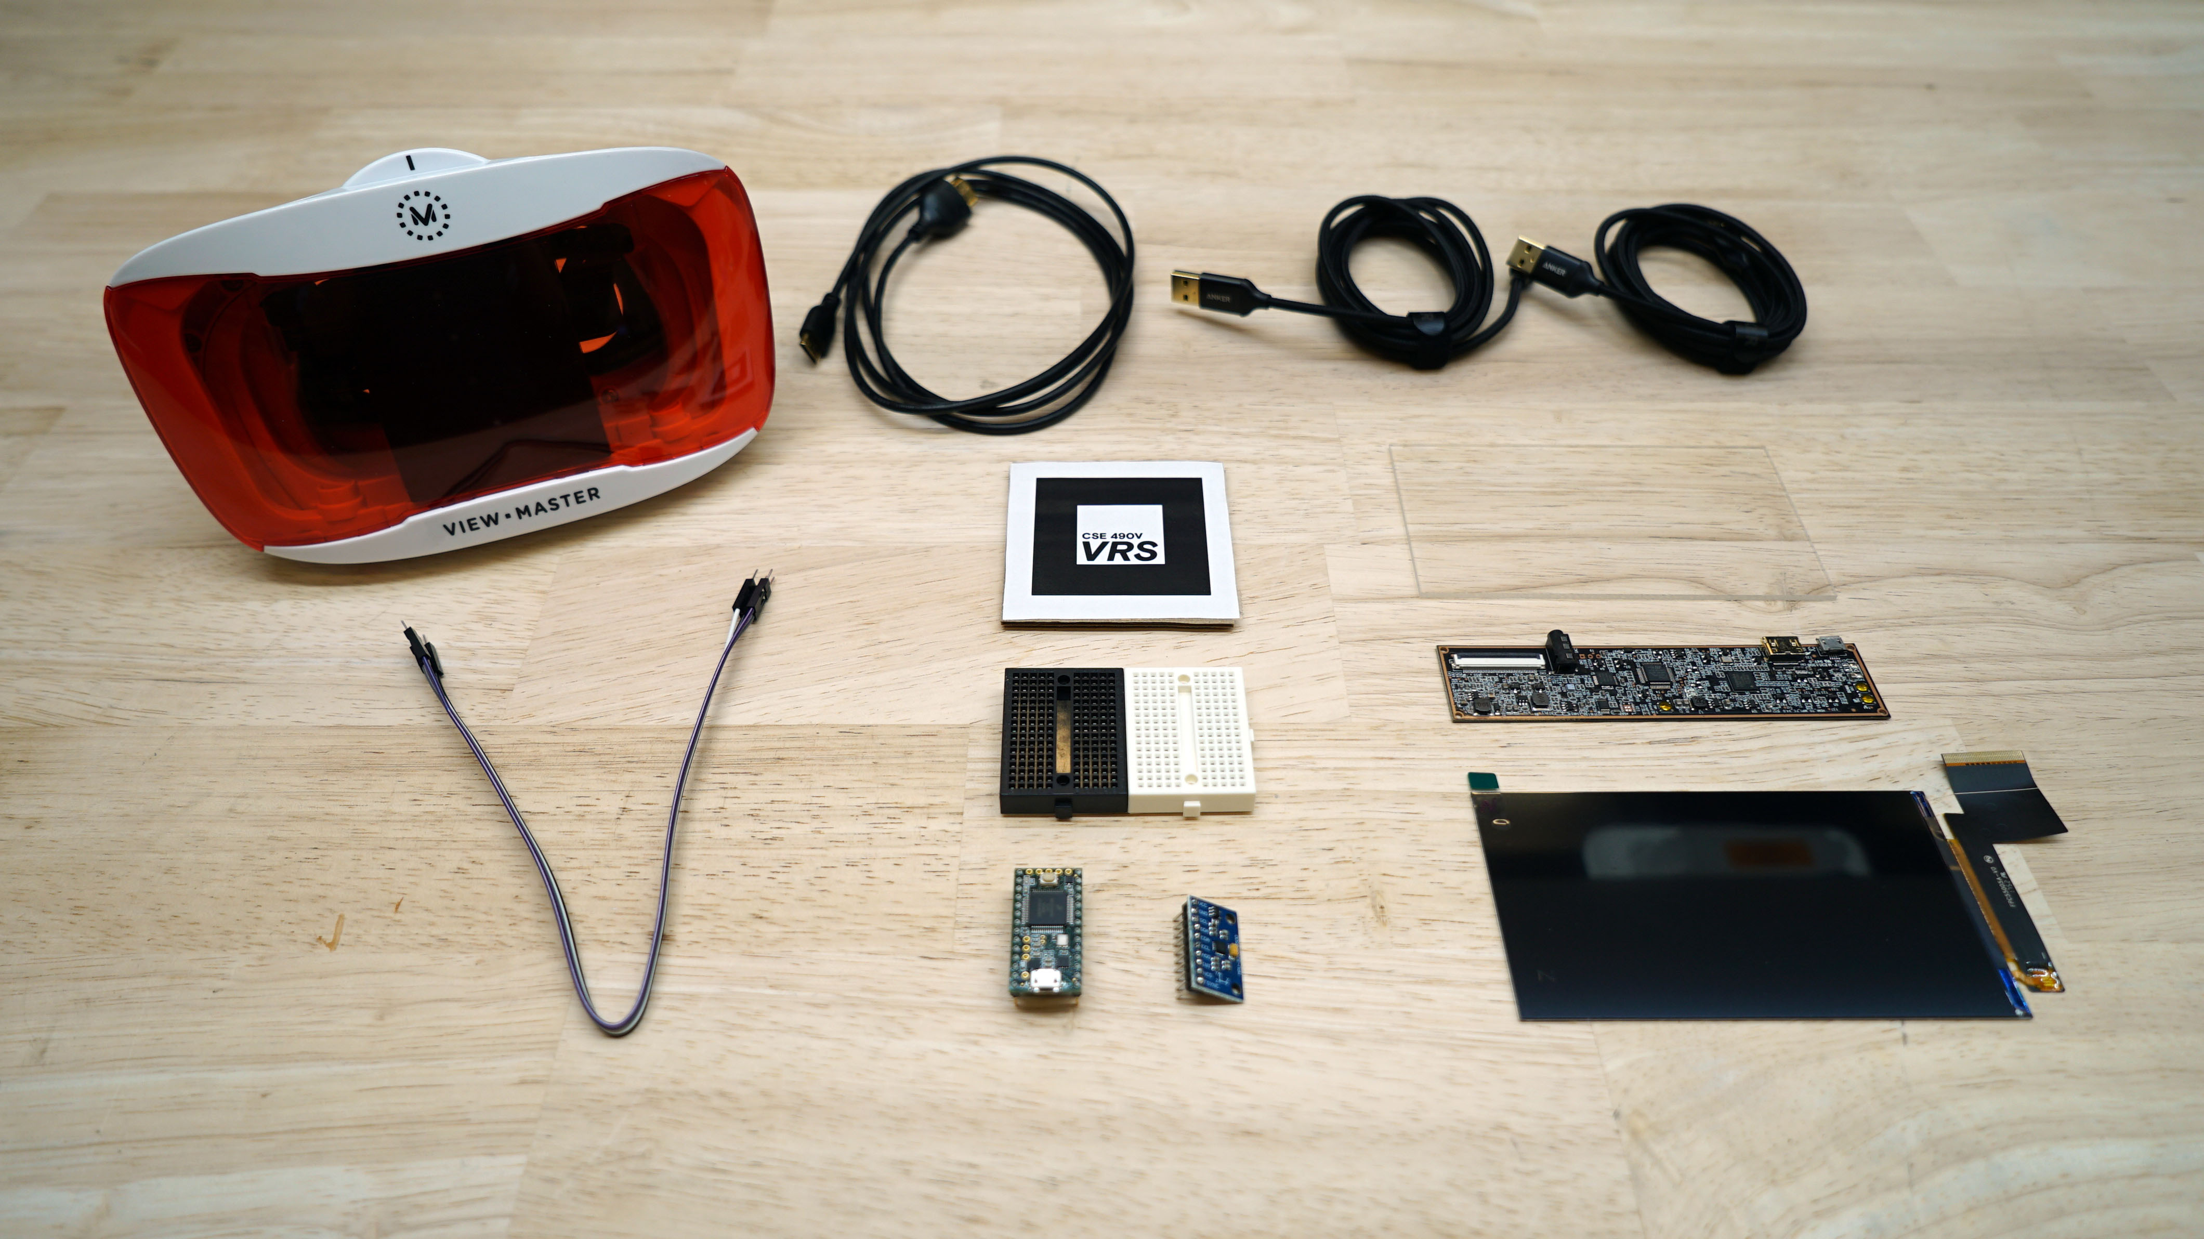
HARDWARE PHOTOS AND VIDEOS

Slide 14
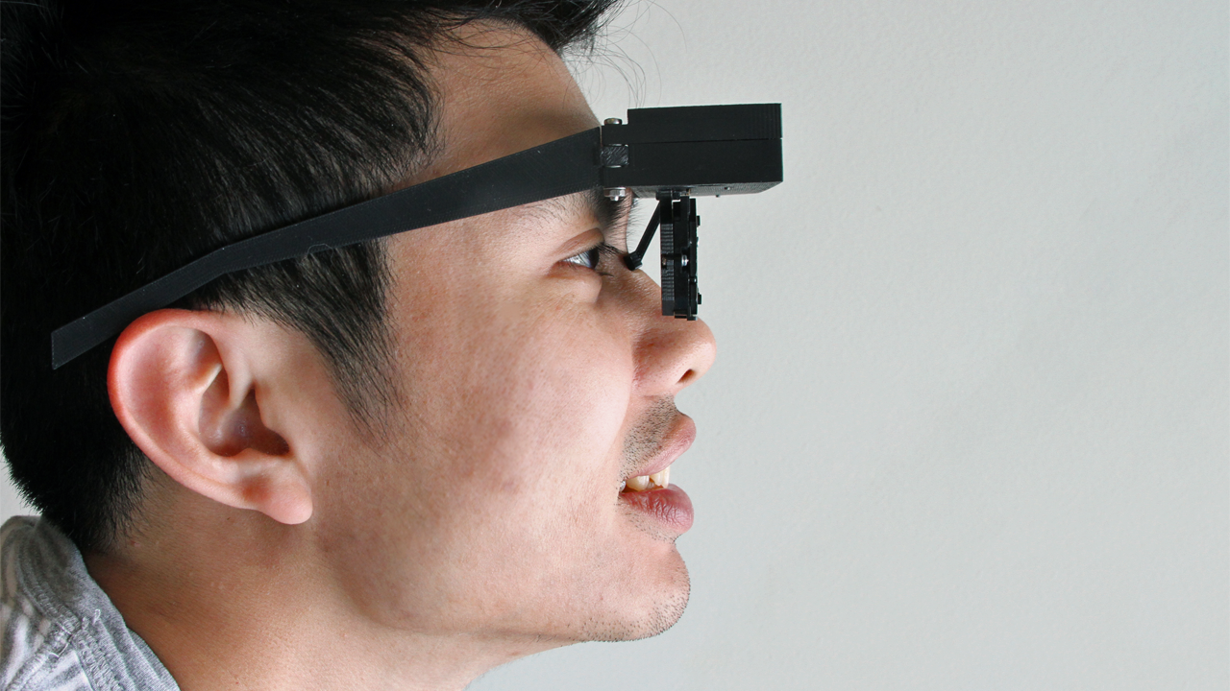
HARDWARE PHOTOS AND VIDEOS
Lanman and Luebke. 2013. Near-Eye Light Field Displays. ACM SIGGRAPH Asia.

Slide 15
EVALUATION OF RESULTS

Slide 16
USER STUDY RESULTS
If you have a user study, then explain the procedure you used to gather data, including the test environment (real and virtual), the number of users, the questionnaire, and plots of the resulting data.

Slide 17
QUANTITATIVE PERFORMANCE VS. PRIOR WORK
If you implemented an algorithm, then try to quantitatively compare it to prior methods in this section. You could compare frame rate (e.g., fps) or image quality (e.g., PSNR or SSIM metrics). Your goal is to show that your implementation works and, where possible, how it compares to prior work. If there is no prior work or you couldn’t make comparisons in the time you had for this project, then note that. You might want to default to subjective assessment (e.g., include quotes from individuals that tried the demo and what they reported afterward, both positively and negatively).

Slide 18
DISCUSSION

Slide 19
BENEFITS AND LIMITATIONS
You could combine this section with the evaluation section. In any case, be sure to clearly call out a list of what’s good and what’s bad with your approach. If it worked on cases that other algorithms fail on, make sure to show that and try to explain why it did. If it had lots of problems, then try to justify why that outcome makes sense in hindsight.

Slide 20
FAILURE CASES
Make sure to explain failure cases. In practice, most implementations or algorithms have their limitations. Try to clearly show where your system is lacking. The goal is to define a path for future research. If you were to continue working on this project, what would you work on next?

Slide 21
CONCLUSION

Slide 22
SUMMARY OF CONTRIBUTIONS
You can end your talk by repeating your motivation/overview materials. Now everyone understands what you claimed at the beginning. Remind the audience why this problem matters, what you did, and what you learned as a result.

Slide 23
FUTURE WORK
Another good way to end is to talk about the future. If you plan on continuing your project, then say what you’ll be working on. If not, or you already covered future work, then this slide may be redundant and can be cut.

Slide 24
APPENDIX

Slide 25
ADDITIONAL RESULTS
Make sure to include additional results, if you expect the audience to ask about certain things you didn’t have time to cover.

Slide 26
MATHEMATICAL DERIVATIONS
Try to limit the amount of math in your talk, unless your primary contributions involve math. Use visuals to explain concepts whenever possible; but, for some projects, you’ll want to have the mathematics in the appendix, in case someone wants to ask questions.

